Slide 1
bef Explained

Slide 2
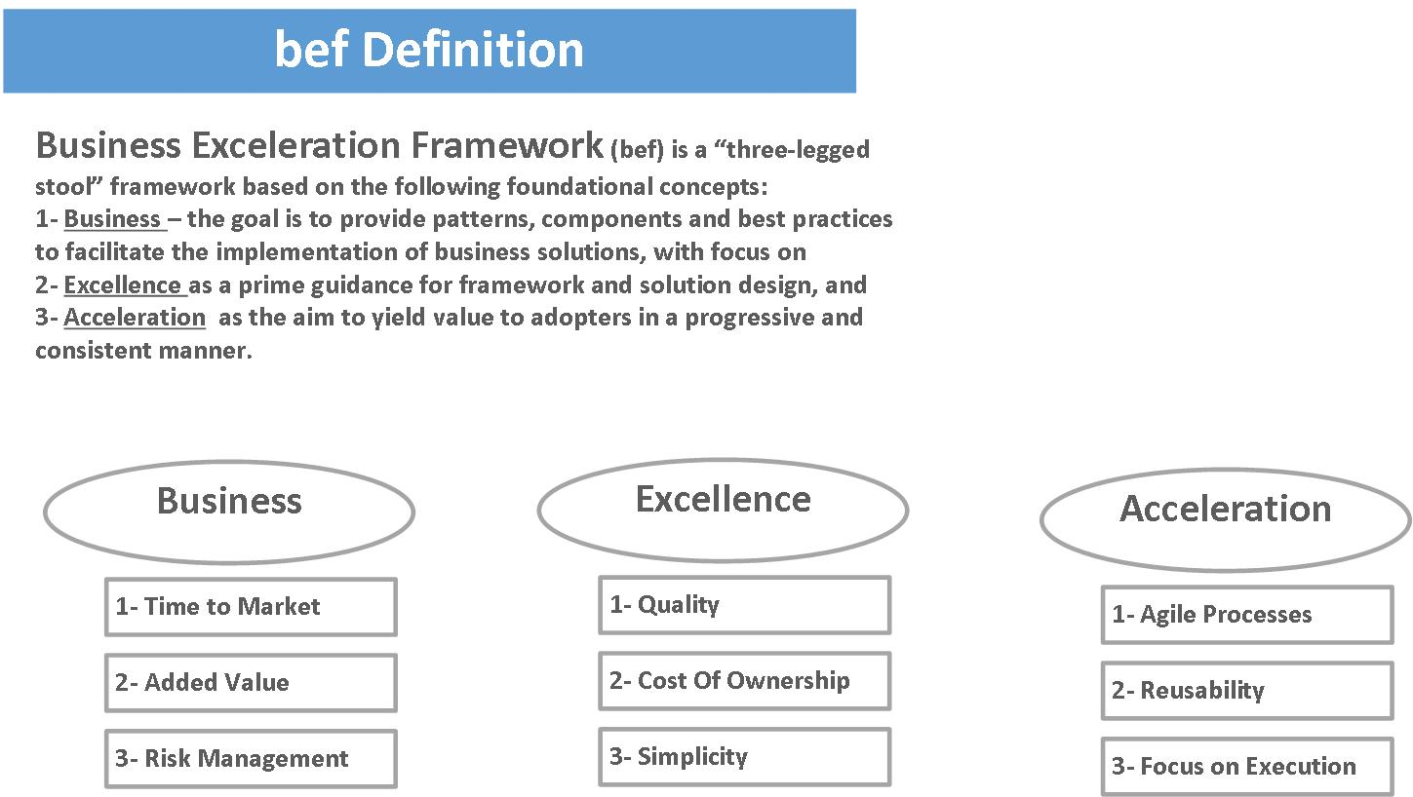
bef Explained

Slide 3
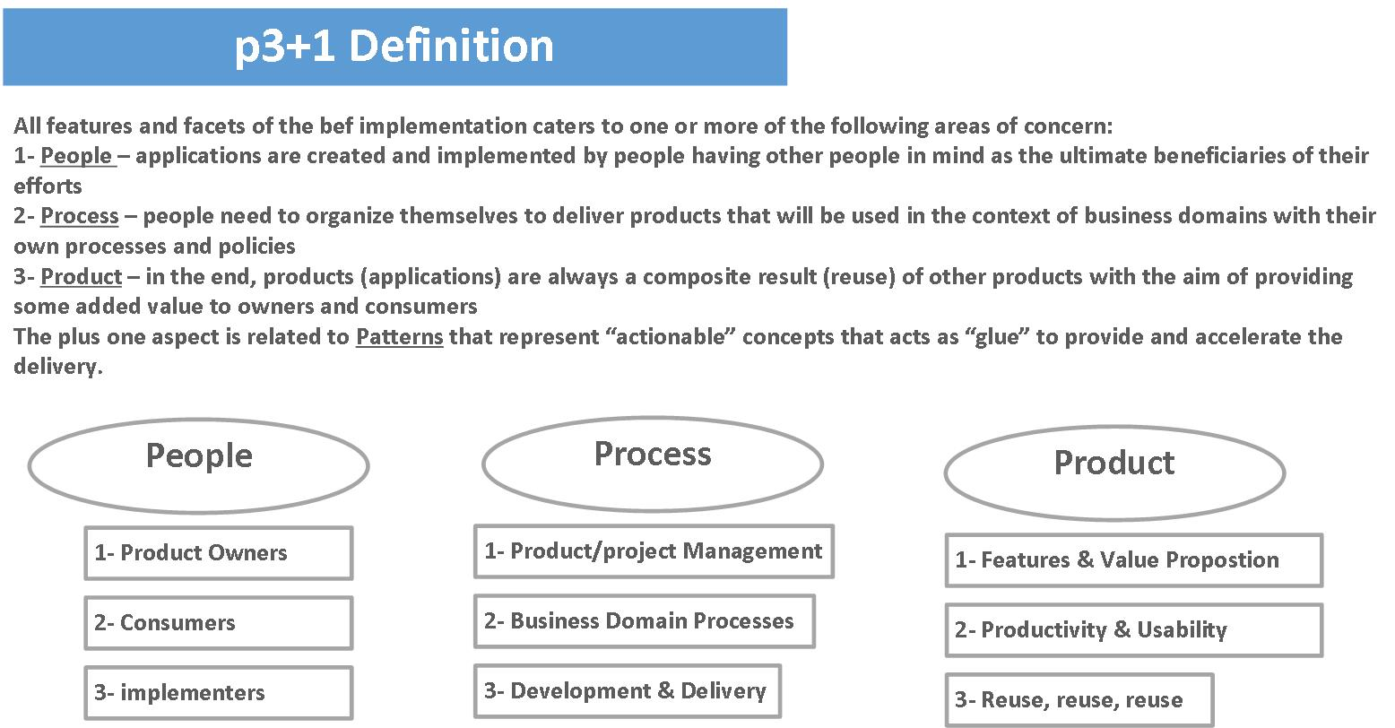
Areas Of Concern

Slide 4
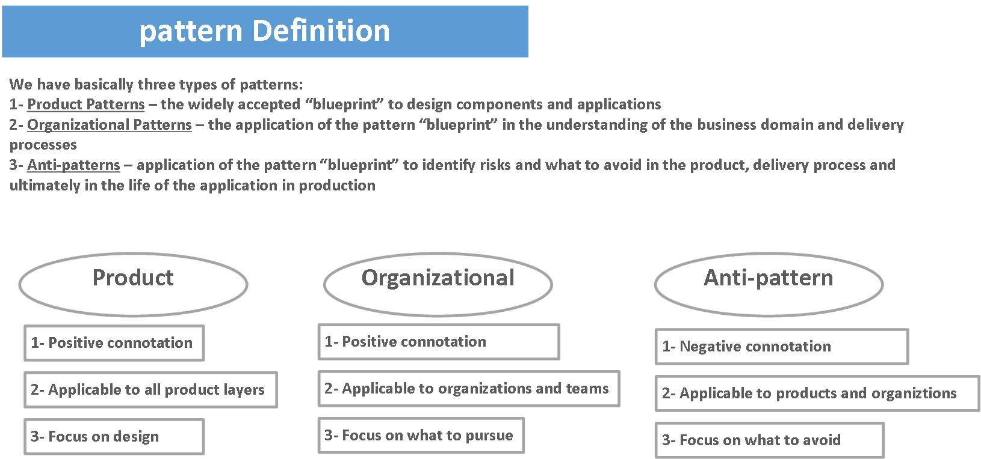
Pattern Categories

